Slide 1
Today’s Class
Housekeeping:
Midterm Project due by 11:59PM on Sunday, 1 Nov. 2020
6:00PM – 7:30PM: dplyr part one (data manipulation)
7:45PM – 8:45PM: tidyr functions for data reshaping
9:00PM – 9:50PM: MBTA group challenge

Slide 2
Clean & tidy
data structures
Visualize
Get
Clean
Transform
Communicate
Model
Understand
Program
☨A modified version of Hadley Wickham’s analytic process

Slide 3

what is tidy data?
Notes:
Tidy data is a standard way of mapping the meaning of a dataset to its structure. A dataset is messy or tidy depending on how rows, columns and tables are matched up with observations, variables and types. In tidy data: 1. Each variable forms a column. 2. Each observation forms a row. 3. Each type of observational unit forms a table

Slide 4
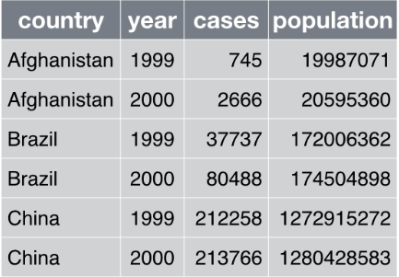
Where are the variables, observations, and values?

Slide 5
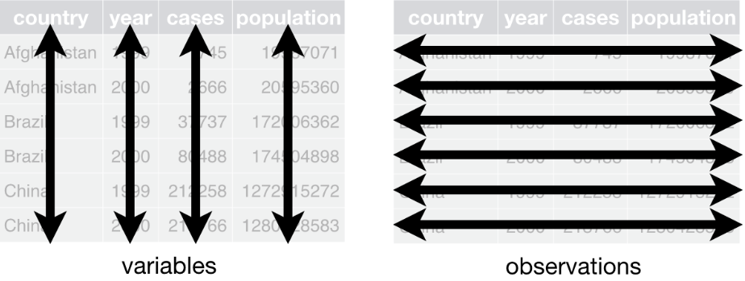
Where are the variables, observations, and values?

Slide 6
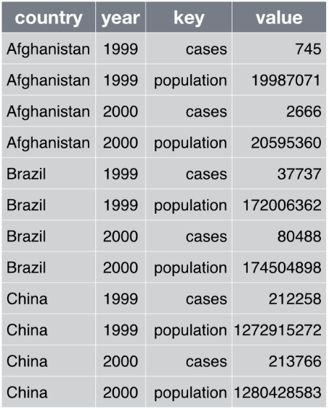
Where are the variables, observations, and values?

Slide 7
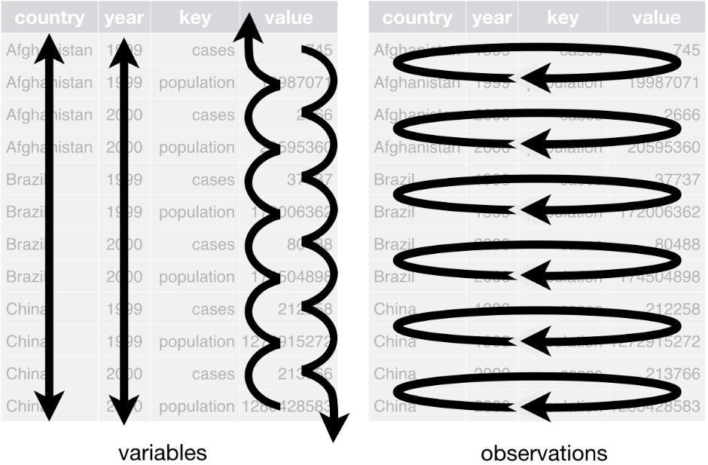
Where are the variables, observations, and values?

Slide 8
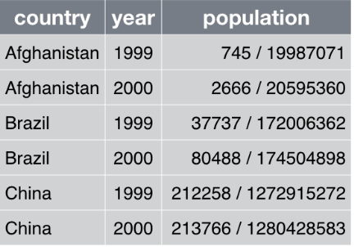
Where are the variables, observations, and values?

Slide 9
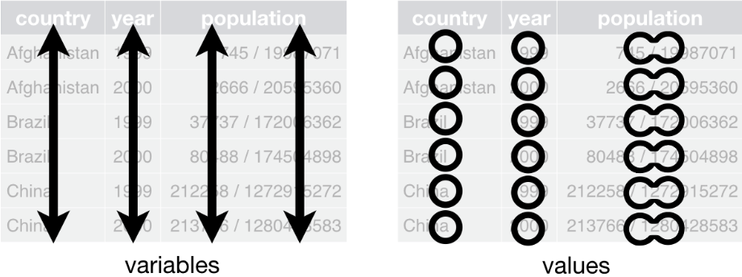
Where are the variables, observations, and values?

Slide 10
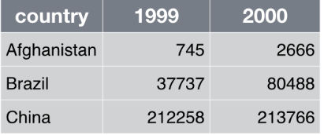
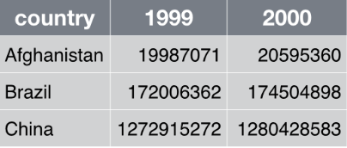
Where are the variables, observations, and values?

Slide 11
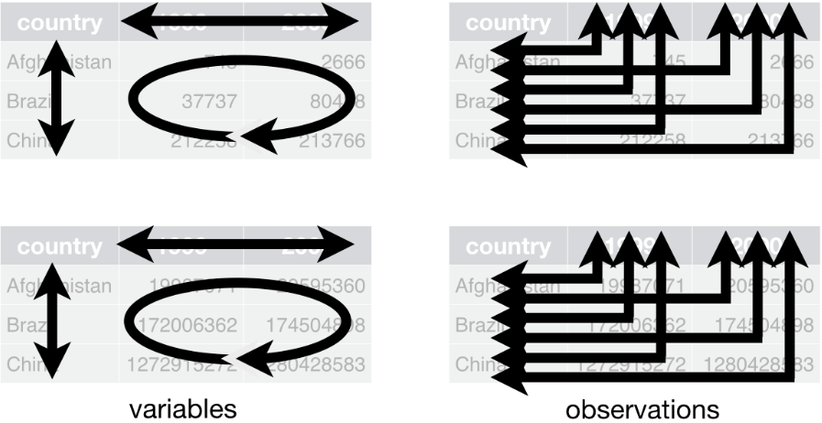
Where are the variables, observations, and values?

Slide 12

Tidying data

Slide 13

tidyr
You will learn four key tidyr functions that allow you to solve the vast majority of your data tidying challenges:
gather:
spread:
separate:
unite:

Slide 14
tidyr
You will learn four key tidyr functions that allow you to solve the vast majority of your data tidying challenges:
gather ( or pivot_longer): transforms data from wide to long
spread: transforms data from long to wide
separate: splits a single column into multiple columns
unite: combines multiple columns into a single column

Slide 15
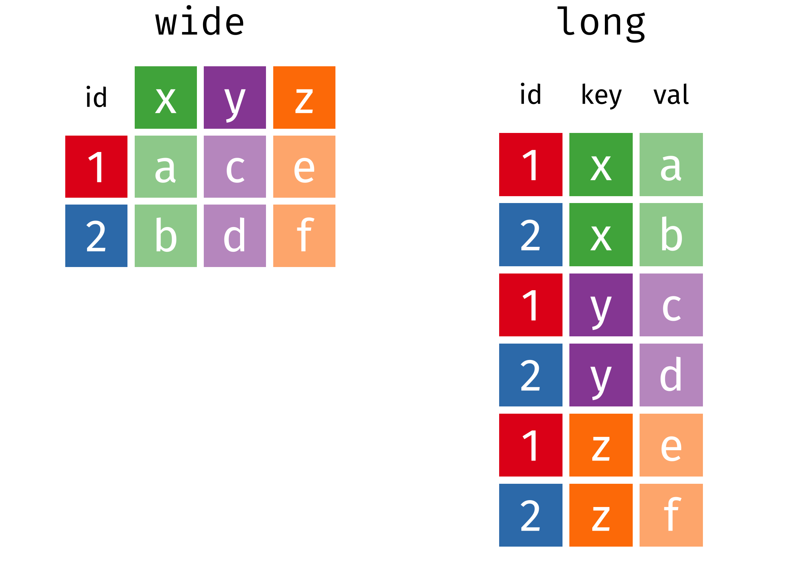
WIDE VS. LONG DATA

Slide 16

prerequisites

Slide 17
prerequisites
Make sure your working directory is set to the course folder
Should have downloaded the folder for today’s class from the course website
We will use the various data sets in the data folder

Slide 18
package prerequisite
library(tidyverse)
-- Attaching packages --------------------------------------- tidyverse 1.3.0 --
v ggplot2 3.3.2 v purrr 0.3.4
v tibble 3.0.1 v dplyr 0.8.5
v tidyr 1.0.3 v stringr 1.4.0
v readr 1.4.0 v forcats 0.5.0
-- Conflicts ------------------------------------------ tidyverse_conflicts() --
x dplyr::filter() masks stats::filter()
x dplyr::lag() masks stats::lag()

Slide 19

gather()
Transform data from wide to long

Slide 20
gather()

Slide 21
gather()

Slide 22
gather()

Slide 23
gather()

Slide 24
gather()
Code alternatives:
# These all produce the same results:
cases %>% gather(Year, n, `2011`:`2013`)
cases %>% gather(Year, n, `2011`, `2012`, `2013`)
cases %>% gather(Year, n, 2:4)
cases %>% gather(Year, n, -Country)
# Also note that if you do not supply arguments for na.rm or convert values then the defaults are used

Slide 25
Your turn!
Import the bomber_wide.rds file in the data folder
Reshape this data from wide to long, but keep the Type and MD columns as-is

Slide 26
Solution
read_rds(“data/bomber_wide.rds”) %>%
gather(Year, Value, -c(Type, MD))
Type MD Year Value
1 Bomber B-1 1996 26914
2 Bomber B-2 1996 2364
3 Bomber B-52 1996 28511
4 Bomber B-1 1997 25219
5 Bomber B-2 1997 2776
6 Bomber B-52 1997 26034
7 Bomber B-1 1998 24205
8 Bomber B-2 1998 2166
9 Bomber B-52 1998 25639
10 Bomber B-1 1999 23306
11 Bomber B-2 1999 3672
12 Bomber B-52 1999 24500
13 Bomber B-1 2000 25013
14 Bomber B-2 2000 4543
15 Bomber B-52 2000 24387
Notes:
read_rds("data/bomber_wide.rds") %>% pivot_longer(c(3:21),"Year")

Slide 27

spread()
Transform data from long to wide

Slide 28
spread()

Slide 29
spread()

Slide 30
spread()

Slide 31
Your turn!
Import the bomber_long.rds file in the data folder
Reshape this data from long to wide
Type, MD, FY, Cost, FH, Gallons

Slide 32
Solution
read_rds("data/bomber_long.rds") %>%
spread(Output, Value)
Type MD FY Cost FH Gallons
1 Bomber B-1 1996 72753781 26914 88594449
2 Bomber B-1 1997 71297263 25219 85484074
3 Bomber B-1 1998 84026805 24205 85259038
4 Bomber B-1 1999 71848336 23306 79323816
5 Bomber B-1 2000 58439777 25013 86230284
6 Bomber B-1 2001 94946077 25059 86892432
7 Bomber B-1 2002 96458536 26581 89198262
8 Bomber B-1 2003 68650070 21491 74485788
9 Bomber B-1 2004 101895634 28118 101397707
10 Bomber B-1 2005 124816690 21859 78410415
11 Bomber B-1 2006 174627869 20163 69984142
12 Bomber B-1 2007 204486404 24629 85112485
13 Bomber B-1 2008 266109848 23024 78084791
14 Bomber B-1 2009 185902082 23065 81030579
15 Bomber B-1 2010 237413270 23398 81253214

Slide 33

separate()
Split a single column into multiple columns

Slide 34
separate()

Slide 35
separate()

Slide 36
separate()

Slide 37
separate()

Slide 38
separate()
Code alternatives:
# These all produce the same results:
storms %>% separate(date, c("year", "month", “day"))
storms %>% separate(date, c("year", "month", "day"), sep = "-")
# By default, if no separator is specified, will separate by any regular expression that matches # any sequence of non-alphanumeric values

Slide 39
Your turn!
Import the bomber_combined.rds file in the data folder
Separate the AC variable into “Type” and “MD”. Hint: An example of a Type is “Bomber”.

Slide 40
Solution
read_rds("data/bomber_combined.rds") %>%
separate(AC, into = c("Type", "MD"), sep = " ")
Type MD FY Cost FH Gallons
1 Bomber B-1 1996 72753781 26914 88594449
2 Bomber B-1 1997 71297263 25219 85484074
3 Bomber B-1 1998 84026805 24205 85259038
4 Bomber B-1 1999 71848336 23306 79323816
5 Bomber B-1 2000 58439777 25013 86230284
6 Bomber B-1 2001 94946077 25059 86892432
7 Bomber B-1 2002 96458536 26581 89198262
8 Bomber B-1 2003 68650070 21491 74485788
9 Bomber B-1 2004 101895634 28118 101397707
10 Bomber B-1 2005 124816690 21859 78410415
11 Bomber B-1 2006 174627869 20163 69984142
12 Bomber B-1 2007 204486404 24629 85112485
13 Bomber B-1 2008 266109848 23024 78084791
14 Bomber B-1 2009 185902082 23065 81030579
15 Bomber B-1 2010 237413270 23398 81253214

Slide 41

unite()
Combine multiple columns into a single column

Slide 42
unite()

Slide 43
unite()

Slide 44
unite()

Slide 45
unite()

Slide 46
unite()
Code alternatives:
# These all produce the same results:
storms %>% unite(date, year, month, day, sep = “_")
storms %>% unite(date, year, month, day)
# If no separator is identified, "_" will automatically be used

Slide 47
Your turn!
Import the bomber_prefix.rds file in the data folder
Unite the prefix and number columns into a “MD” variable with “-“ separator

Slide 48
Solution
read_rds("data/bomber_prefix.rds") %>%
unite(MD, prefix, number, sep = "-")
Type MD FY Output Value
1 Bomber B-1 1996 FH 26914
2 Bomber B-1 1997 FH 25219
3 Bomber B-1 1998 FH 24205
4 Bomber B-1 1999 FH 23306
5 Bomber B-1 2000 FH 25013
6 Bomber B-1 2001 FH 25059
7 Bomber B-1 2002 FH 26581
8 Bomber B-1 2003 FH 21491
9 Bomber B-1 2004 FH 28118
10 Bomber B-1 2005 FH 21859
11 Bomber B-1 2006 FH 20163
12 Bomber B-1 2007 FH 24629
13 Bomber B-1 2008 FH 23024
14 Bomber B-1 2009 FH 23065
15 Bomber B-1 2010 FH 23398

Slide 49

challenge

Slide 50
Import the bomber_mess.rds file in the data folder
Clean this data up so it looks like:
# A tibble: 57 × 6
Type MD FY Cost FH Gallons
* <chr> <chr> <chr> <int> <int> <int>
1 Bomber B-1 1996 72753781 26914 88594449
2 Bomber B-1 1997 71297263 25219 85484074
3 Bomber B-1 1998 84026805 24205 85259038
4 Bomber B-1 1999 71848336 23306 79323816
5 Bomber B-1 2000 58439777 25013 86230284
6 Bomber B-1 2001 94946077 25059 86892432
7 Bomber B-1 2002 96458536 26581 89198262
8 Bomber B-1 2003 68650070 21491 74485788
9 Bomber B-1 2004 101895634 28118 101397707
10 Bomber B-1 2005 124816690 21859 78410415
# ... with 47 more rows

Slide 51
Solution
read_rds("data/bomber_mess.rds") %>%
unite(col = MD, prefix:number, sep = "-") %>%
separate(Metric, into = c("FY", "Output")) %>%
spread(Output, Value) %>%
as_tibble()
# A tibble: 57 × 6
Type MD FY Cost FH Gallons
* <chr> <chr> <chr> <int> <int> <int>
1 Bomber B-1 1996 72753781 26914 88594449
2 Bomber B-1 1997 71297263 25219 85484074
3 Bomber B-1 1998 84026805 24205 85259038
4 Bomber B-1 1999 71848336 23306 79323816
5 Bomber B-1 2000 58439777 25013 86230284
6 Bomber B-1 2001 94946077 25059 86892432
7 Bomber B-1 2002 96458536 26581 89198262
8 Bomber B-1 2003 68650070 21491 74485788
9 Bomber B-1 2004 101895634 28118 101397707
10 Bomber B-1 2005 124816690 21859 78410415
# ... with 47 more rows

Slide 52
practice makes (nearly) perfect!
Let’s review/apply what you’ve learned with a use-case

Slide 53

mbta ridership

Slide 54
Group worK
Spend the next 45 minutes working through the tasks in the “Session_3_-_MBTA_Exercise” PDF in the class download folder.
Due: Oct 27th 2020 11:59PM, submit via slack

Slide 55

Project work

Slide 56
project work
Spend the remaining (if any) class time working on developing your mid-term project assessment. This includes importing, understanding, and cleaning your final project data. See the “session3_Mid_term_Project” PDF in the class download folder.
Leverage your classmates' intelligence!

Slide 57


